Slide 1
Predicting Genetic Variants that are Conflicting Classified
Gurdeep Sullan
Springboard Data Science Career Track
Capstone Project I
03/11/2020

Slide 2
Genetic Testing - A Quick Background
Reasons for genetic testing:
Pre-emptive screening for inherited diseases
Diagnosis confirmation
Patient samples are sent to one or more labs to test for specific variants
The result is scored on a 5-level scale as shown below:
Results guide treatment and healthcare planning
Notes:
Why do we do genetic testing?
How does genetic testing work?

Slide 3

Problem Statement
A large problem in genetic testing is that some mutations are consistently classified, while other mutations receive conflicting classifications when tested at different laboratories.
What makes a genetic variant more prone to be conflictingly classified versus consistently classified? Given the features of a variant, can we predict if it will be conflictingly classified?

Slide 4
Data Sources
Kaggle competition dataset (https://www.kaggle.com/kevinarvai/clinvar-conflicting)
Originally from ClinVar database (https://www.ncbi.nlm.nih.gov/clinvar/)
Uniprot dataset
Pulled from https://www.uniprot.org/ using a custom search

Slide 5
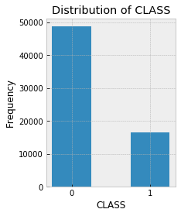
Exploratory Data Analysis (EDA)
65,188 entries
61 numerical features
2 classes:
0 = consistently classified
1 = conflictingly classified
Class imbalance

Slide 6
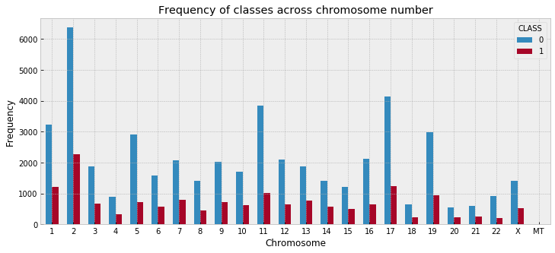
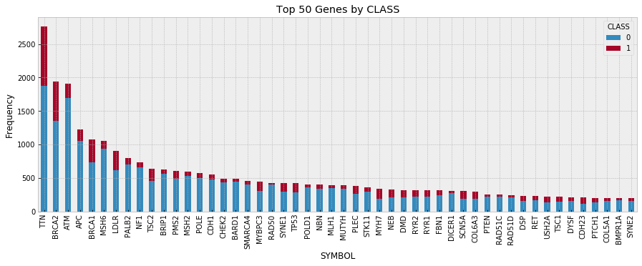
EDA - continued
What types of genes are represented in this dataset?
Notes:
Are some genes more frequently classified? Is one gene or chromosome particularly contentious? This could be based upon available literature

Slide 7
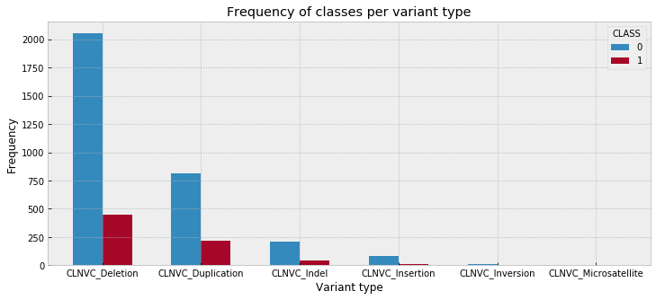
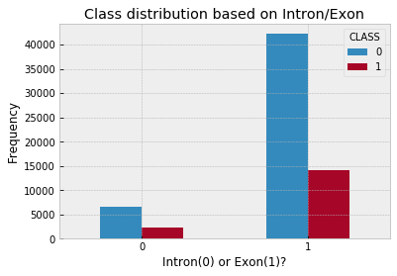
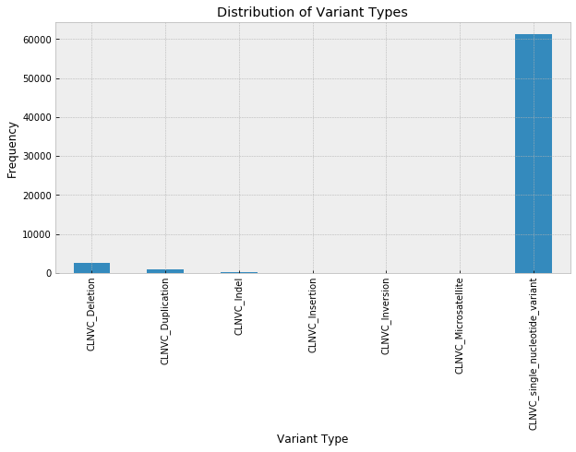
EDA - continued
Are particular genetic variant features observed disparately in one class versus the other?
Notes:
After this EDA and more, I came to the conclusion that this was a multidimensional problem that would require the training of a ML model to predict important features.

Slide 8

Machine Learning Models
Binary classification problem
Four classifiers chosen:
Logistic Regression
Decision Tree Classifier
Random Forest Classifier
XGBoost Classifier

Slide 9
Cross Validation Methods
sklearn methods:
GridSearchCV
RandomizedSearchCV
Choosing a scoring metric:
‘f1’
‘accuracy’
‘Balanced_accuracy’
Future: Bayesian optimization

Slide 10
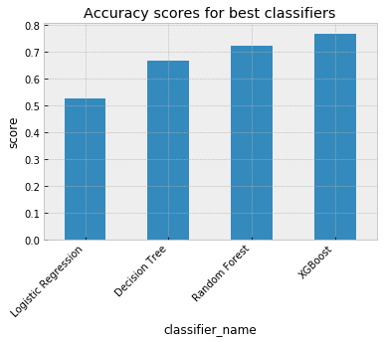
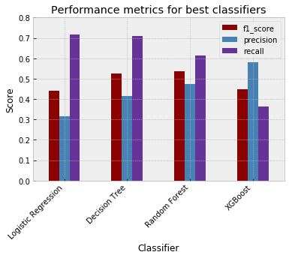
Model Comparison and Evaluation
Classifier | test accuracy | train accuracy | precision | recall | f1 score
Logistic Regression | 0.53 | 0.54 | 0.32 | 0.72 | 0.44
Decision Tree | 0.67 | 0.69 | 0.42 | 0.71 | 0.52
Random Forest | 0.73 | 0.83 | 0.47 | 0.61 | 0.53
XGBoost | 0.77 | 0.93 | 0.58 | 0.36 | 0.45
Notes:
Because this model was predicting the results of a medical test (which has implications on treatment) I wanted to optimize both precision (how many of the positives are TP) and recall (out of all the actual positives, how many were labeled as such). You dont want to needlessly send a patient to get a second genetic test (precision) but you also dont want to miss identifying cases where the patient should get a second test (recall)

Slide 11
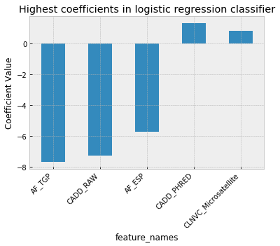
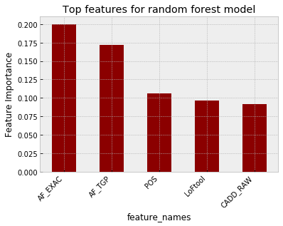
Coefficients and Feature Importances
Notes:
Note: not a 1:1 comparison
“The allele frequency represents the incidence of a gene variant in a population” -nature
Makes sense: the negative relationship indicates that the lower an AF is in the population, the more rare, the higher the chance that the classification with be class=1 (conflictingly classified)

Slide 12
Conclusions
Evaluate models on the f1 score, and not just the test accuracy, due to class imbalance in our dataset
The best performing model is Random Forest Classifier
Allele frequency seems to be an important feature in both Logistic Regression and Random Forest models
In silico predictors are important features in these models - transfer learning

Slide 13
Future Directions and Recommendations
Additional NLP on the categorical features that couldn’t be used
Disease identifier
Variant Consequence
NLP using SentencePiece on raw genome data at genetic loci of variants for information on co-occurring variants, and effects of other variants

Slide 14
Acknowledgments
Springboard
Hobson Lane
Data
ClinVar
Kaggle
Uniprot
Clip art
https://www.springboard.com/blog/machine-learning-engineering/
http://clipart-library.com/confused-cliparts.html

